Slide 1

Software Engineering
Group 11 – Silveros
Members:
Nguyễn Tiến Hoàng (Leader)
Lý Phương Anh
Doãn Văn Huy
Tạ Quang Hiệp
Nguyễn Tùng Anh
Nguyễn Hữu Dũng

Slide 2
Content
I. Project overview
II. What we have done during three months
III. UML Diagram and Lint

Slide 3
I. Project Overview

Slide 4
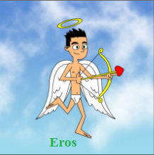
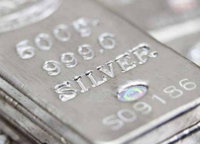
Purpose
Design a dating online website “Silveros”
Silveros

Slide 5
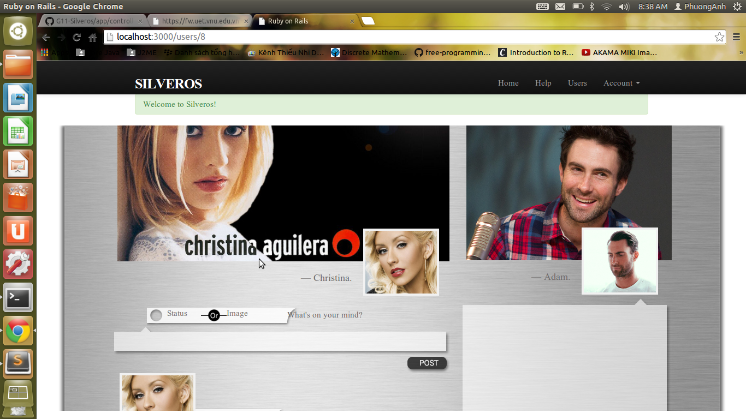
Interfaces

Slide 6
Silveros
Updating your status
Contacting with the community
Getting some amazing tips to go on a date.
Chatting with your friends

Slide 7
Making plan:
Start date: 1/3/2014
End date: 31/8/2014
Scrum:
Daily Scrum: Using group feature on Facebook.
Weekly Scrum: Meeting on Thursday afternoon.
Working:
Using Github: https://github.com/tienhoangna/G11-Silveros
Pivotaltracker: https://www.pivotaltracker.com/s/projects/1040850

Slide 8
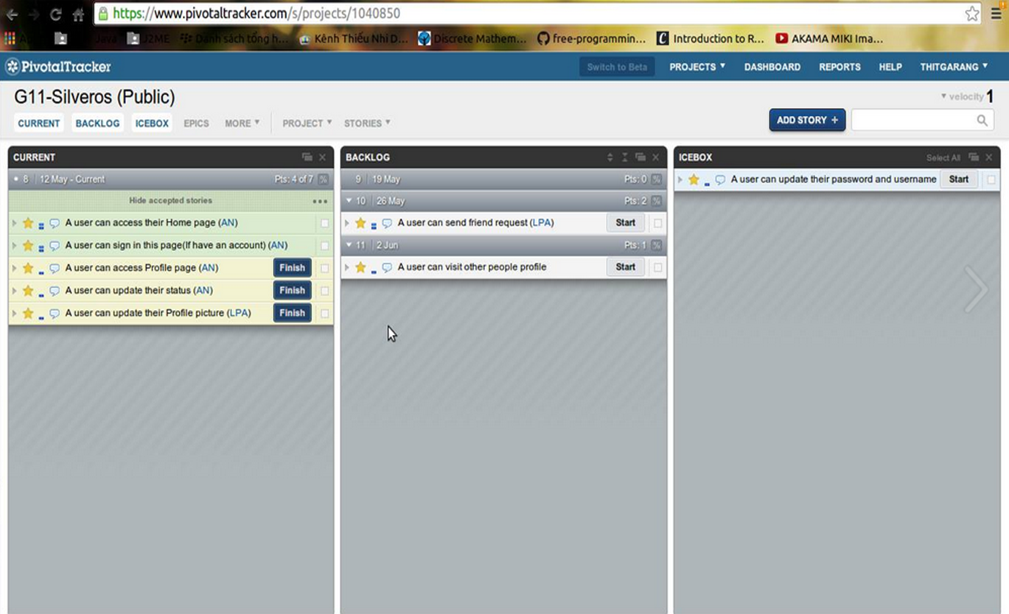
Pivotaltracker

Slide 9
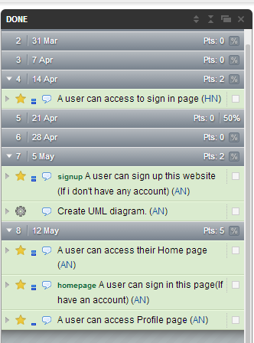
What we have done in pivotal tracker

Slide 10
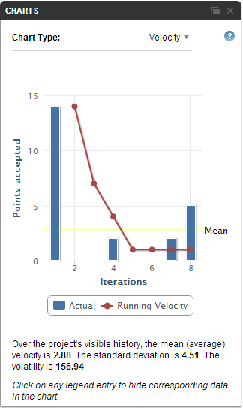
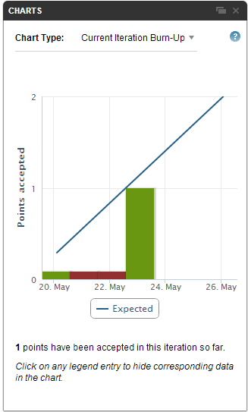
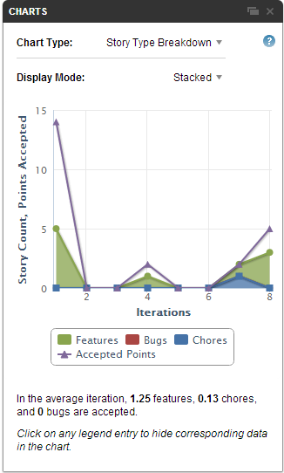

Slide 11
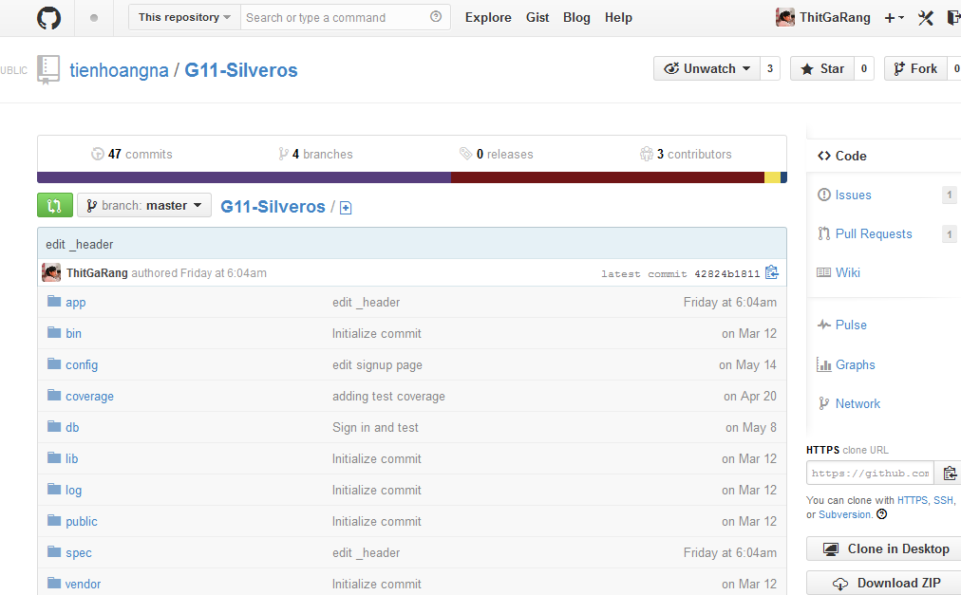
Github

Slide 12

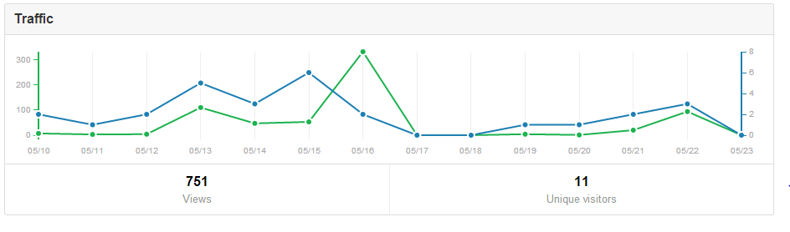

Slide 13
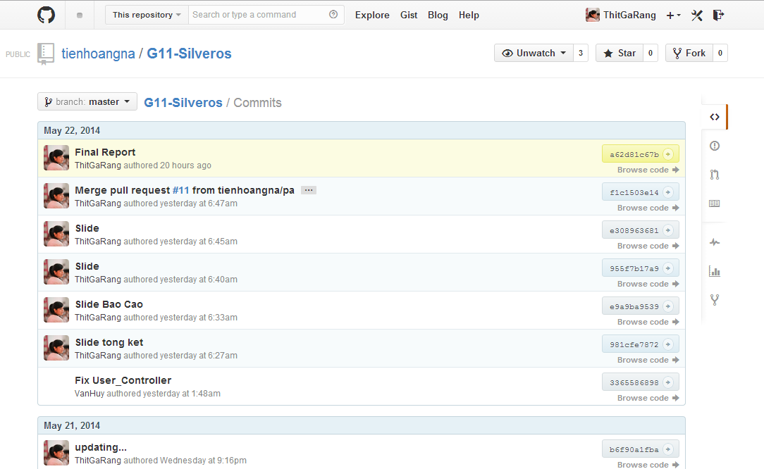

Slide 14
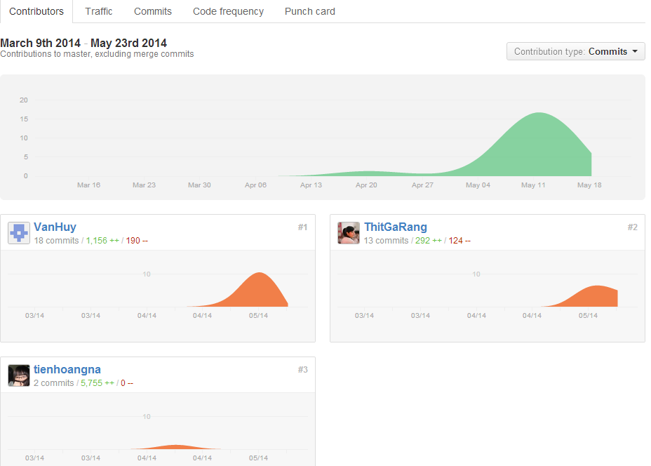

Slide 15
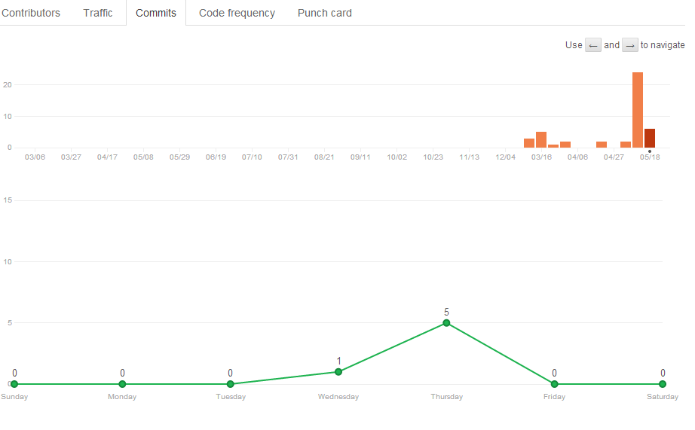

Slide 16
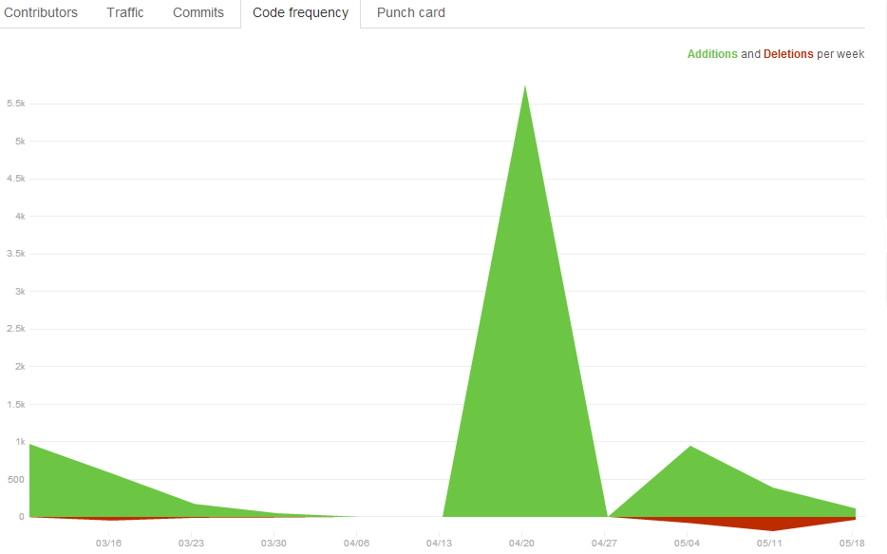

Slide 17
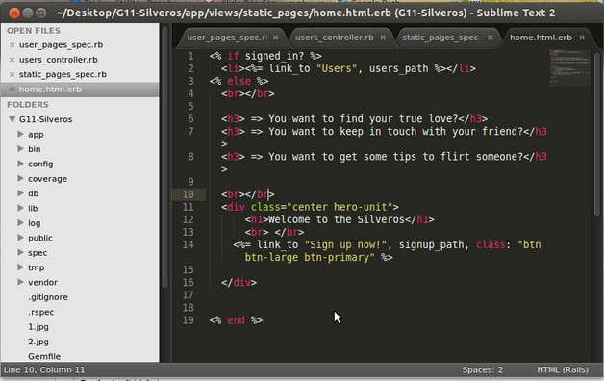
Ruby language with framework Rails
HTML, CSS and Javascript
Rspec for test
Text editor for code is Sublime Text

Slide 18
II. What we have done during three months

Slide 19
From February 21 to the end of this month:
Learn about Scrum
Create idea for project

Slide 20
From March 1 to 15, we had learned:
HTML
CSS
Javascript
From March 16 to the end of month:
Ruby language
Rails framework

Slide 21
In April, We divided our group into 2 small teams:
Team feature had finished first feature: sign in, sign up and sign out.
Team design had also finished Profile page interface.

Slide 22
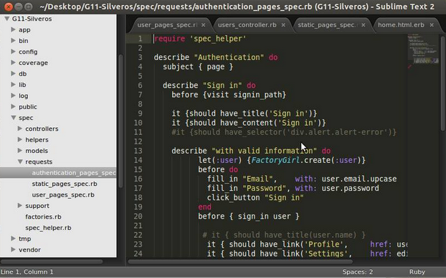
Small part of our test for sign in and sign up

Slide 23
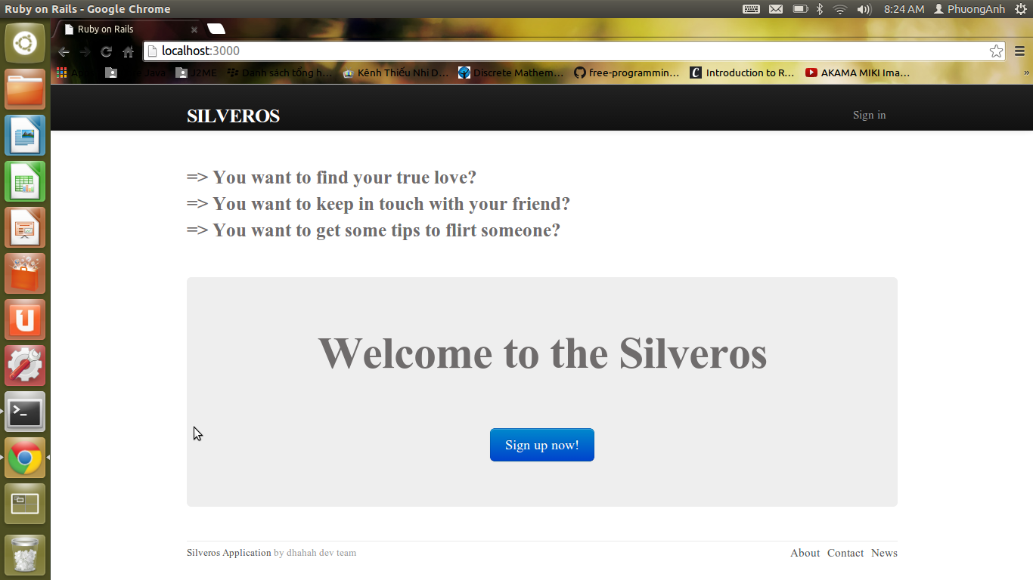
From 1/5 to 12/5: Editing Sign in, sign up page.

Slide 24
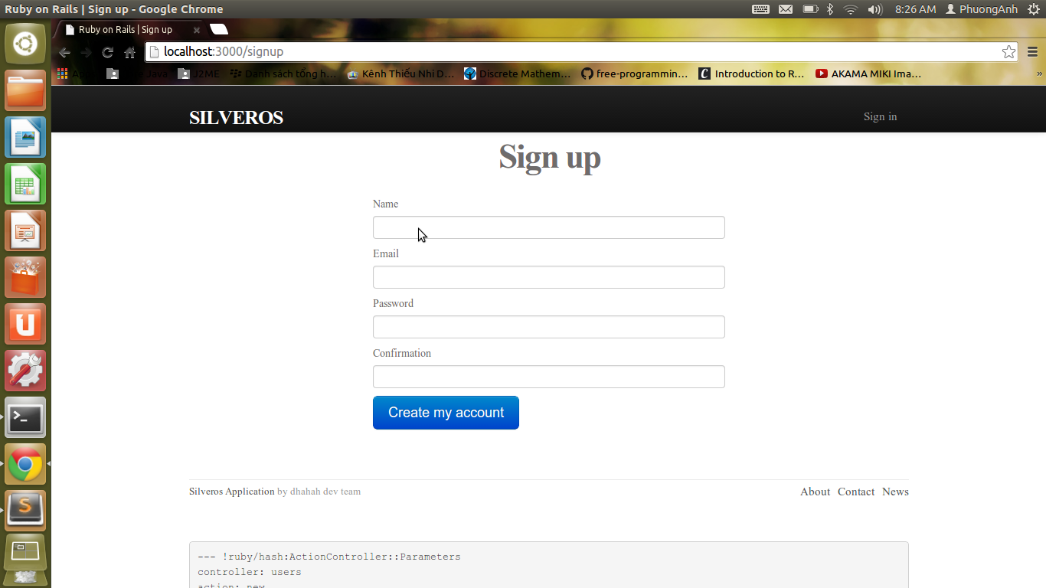

Slide 25
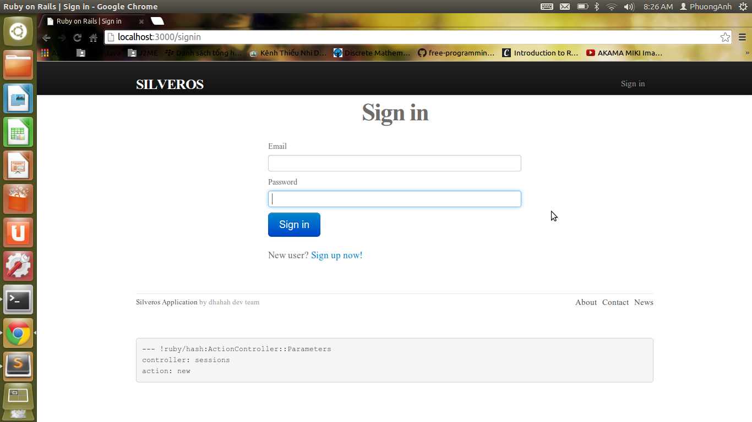

Slide 26
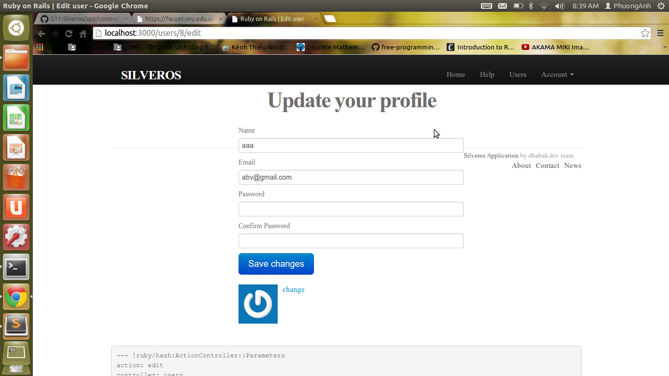

Slide 27
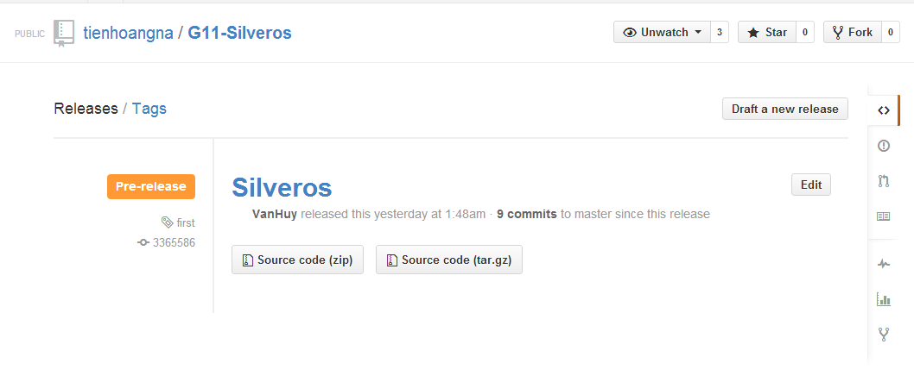
On 22/5/2014
Our product has been first released

Slide 28
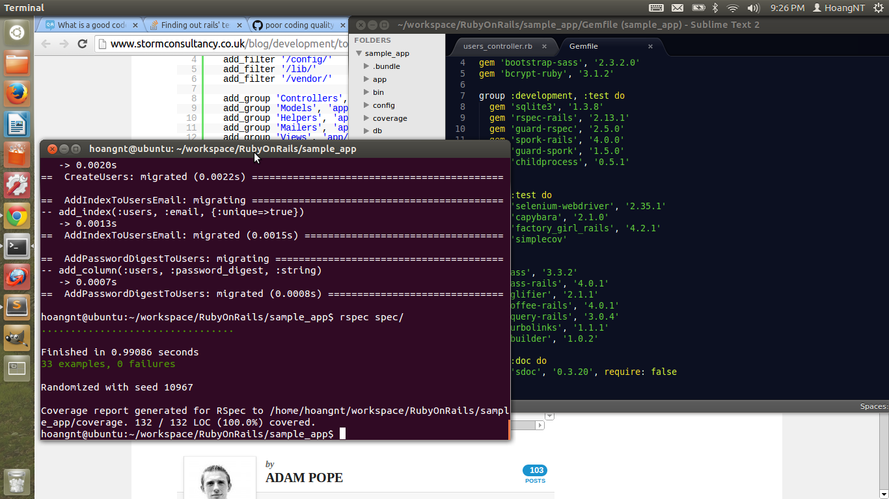
Test coverage

Slide 29
III. UML Diagram

Slide 30
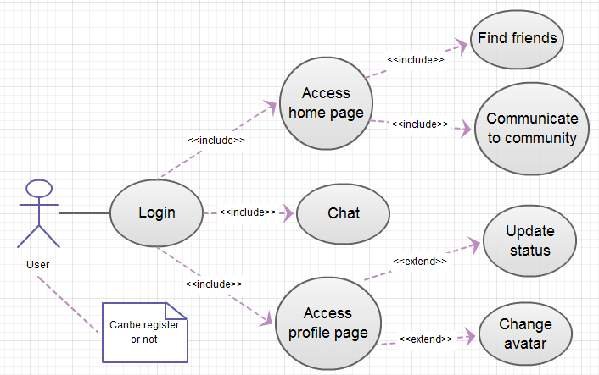
1. Use case Diagram

Slide 31
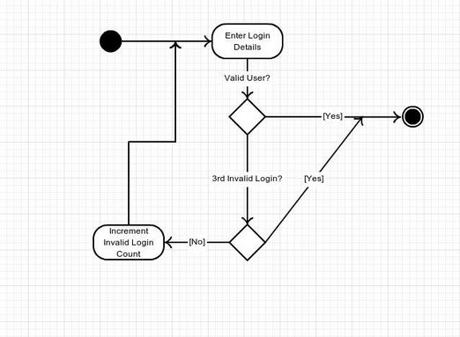
2. Activity Diagram

Slide 32
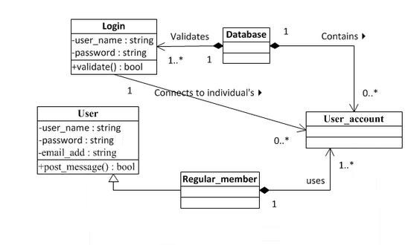
3. Class Diagram

Slide 33
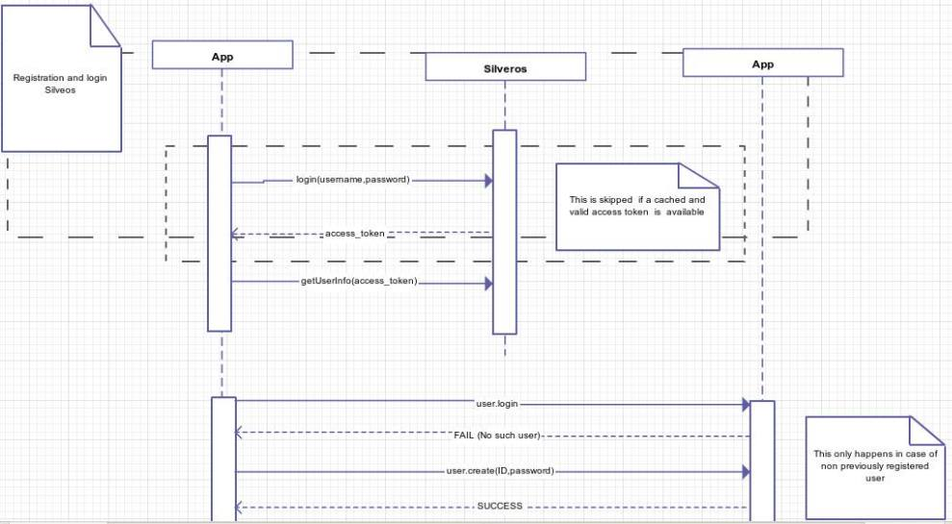
4. Sequence Diagram

Slide 34
IV. LINT

Slide 35
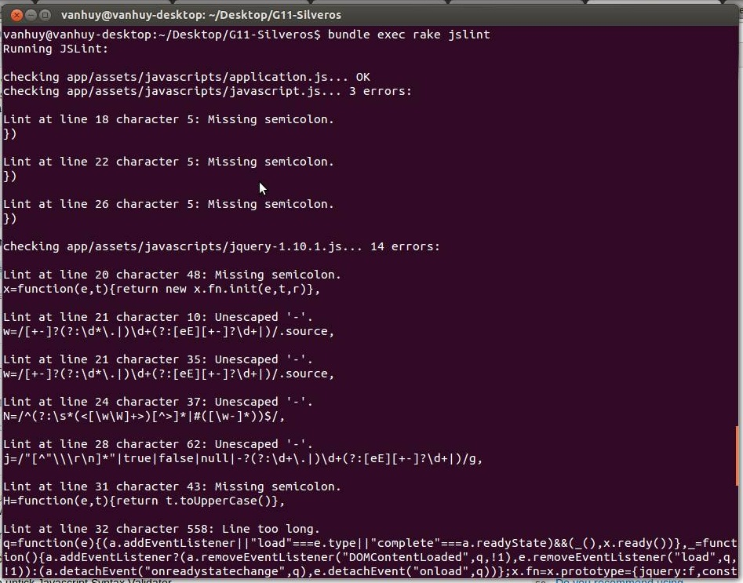

Slide 36
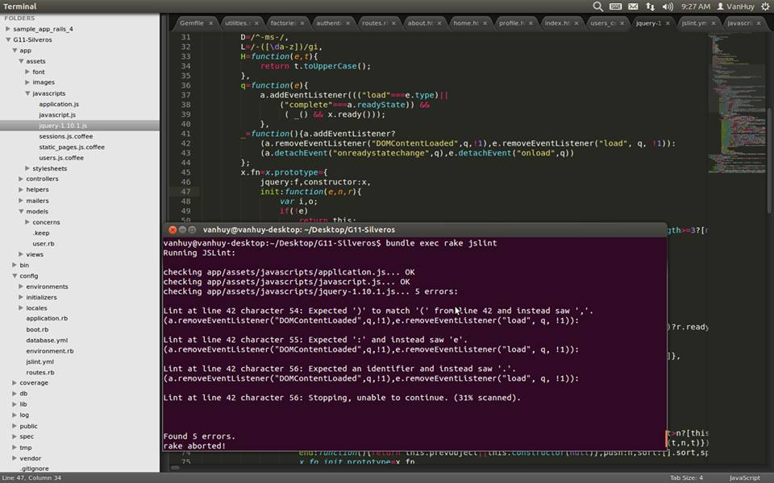

Slide 37
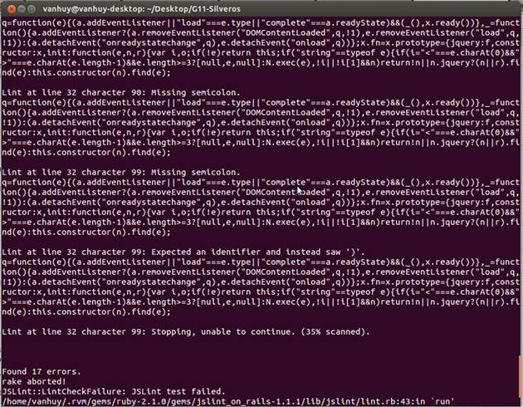

Slide 38
THE END
Thanks for watching :)

